Slide 1
REM Sleep & Job Burnout:
A Conservation of Resources Perspective
O. Dorian Boncoeur
Naveen Jindal School of Management
Notes:
My name is Dorian Boncoeur, I am a PhD candidate from the University of Texas at Dallas
Excited to be here and to share some of the work that I am doing.
I would like to thank each and everyone of you for attending the talk today, and for greeting with such a warm welcome. Special thanks go to Jason and the search committee.
Structure of the talk:
-Background and research area
-Job burnout and REM sleep
-Future research agenda
Feel free to ask your question/comment as we go
=For those joining online:
-I would kindly ask you to stay on mute
-Unmute yourself and ask your question
=If an in-person question, is not heard on Zoom, I will make sure to repeat it

Slide 2

The origins of my research interests
Notes:
I worked in the bar industry through Grad school in Germany (2011-2013): Most staff members were international students like me
Three things that I observed:
-Work carved into sleep often in unpredictable ways
-Some days more than, it was easier to ”enjoy themselves” with the customers
-People were depleted (High rate of turnover); people felt “this could not keep going for long”
When I became a manager, it was clear that I had to balance all of these because:
- can run employees down the ground and get short run benefits
- can get the most from their employees over time and get long run benefits
I was curious: How to foster employees’ ongoing ability to contribute to their organizations without compromising their own selves?
how do you keep people’s energy up in a sustainable way?
Organizational phenomena that are involved in this process for organizational member

Slide 3
My research interests
Promises of Diversity and Inclusion
Sleep and Work (Dissertation)
Perils of Incivility at Work
Affective Processes
Abusive supervision & deviance
(JBE, 2020)
REM sleep & job burnout (writing)
Diversity climate & creativity
(Personnel Psychology, 2019)
REM sleep & job performance (analysis)
Sleep states & energy (data collection)
Engagement & counterproductive work behavior (JBR, 2020)
Receiving gratitude in inclusive climates & work withdrawal
(Under review, OBHDP)
Notes:
How do we get all people to thrive in their organizations?
Diversity & inclusion Personnel Psychology (2019)
How do we know that an organization’s human capital is deteriorating?
Incivility & counterproductive work behavior (CWB) Journal of Business Ethics (2020); Journal of Business Research (2020)
How do employees restore their ability to contribute to their organizations on a daily basis?
Sleep: “A conservation of resources theory approach to the multiple dimensions of sleep in organizational behavior”

Slide 4
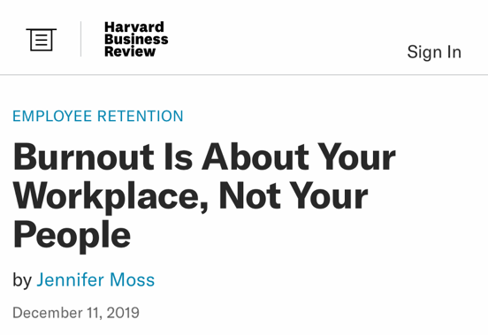
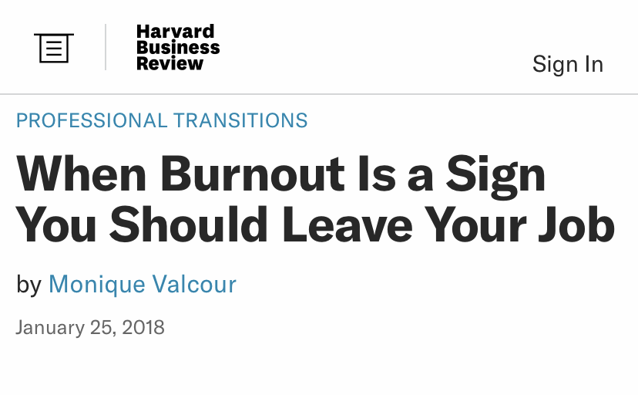
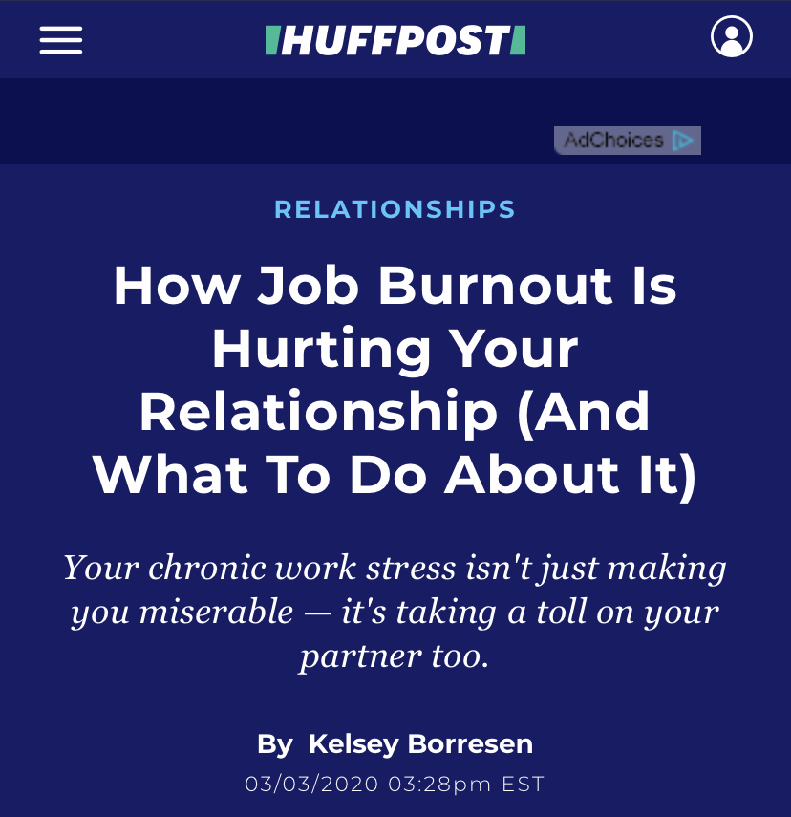
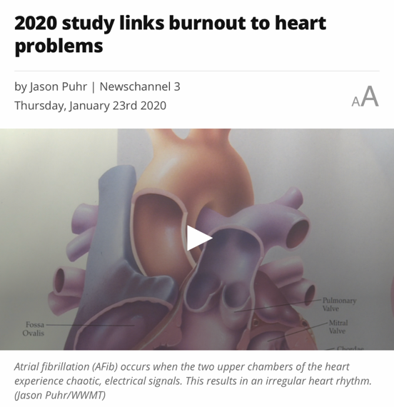
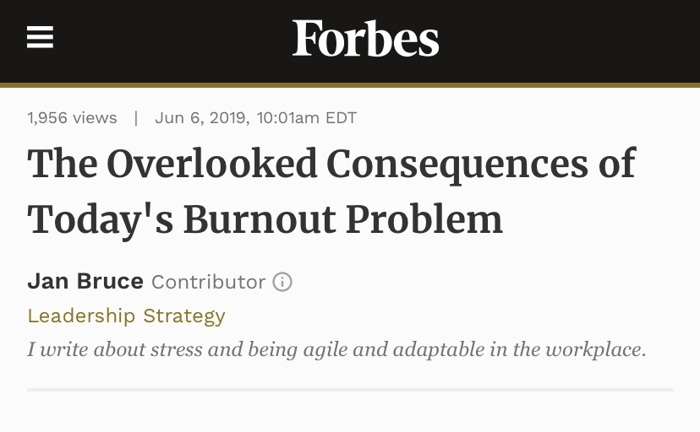
Job burnout
The state of affective, psychological, and cognitive fatigue with general disinterest in the job (Shirom & Melamed, 2006)
Notes:
Job burnout is important sign of a deteriorizing human capital
COVID made it worst
C-level not exempt
WHO
We know through popular press that job burnout is a HUGE problem for
Human capital
Individual problem
Burnout is the absence of sustainability
What do we know?
Job burnout refers to the state of affective, psychological, and cognitive fatigue with general disinterest in the job (Shirom & Melamed, 2006).
It matters for organizations: Experiencing burnout is associated with reduced professional efficacy.
Personality factors: Demographic (age, work experience, marital status, education)
Personality (low levels of hardiness, external locus of control, passive, defensive, lower self-esteem neuroticism, Type-A behavior )
Attitude: High expectations in the job,
Situational factors: job demands
There’s a piece missing: Employees’ daily inability to return to relatively stable equilibrium is implicated
Burnout is a logical extension
I started this talked with the story of how job burnout was salient to most people I was bartending with.
Job Burnout is not something that I was the sole person experiencing
Job burnout is directly relevant human sustainability at work because it is the lack thereof; a good way to operationalize human sustainability
Since May 2019, the WHO included Job burnout in the International Classification of Diseases (ICD-11) as an occupational phenomenon.

Slide 5
Sleep & organizations
Sleep deprivation is ubiquitous in industrialized countries (RAND corp.)
  CDC declaring insufficient sleep a public health problem
  Economic impact of $43 to $56 billion
Understanding sleep and job burnout is important
  Employees are expected to sustain their organizations
  Furthering our understanding of what sustains organizational
  members is paramount
Notes:
Sleep and burnout are in opposition
Americans are working longer hours, cutting into sleep
Yearly estimated loss 1.2 million days of work
Sleep is understood to be the state of (reversible) immobility consisting of greatly diminished physical responsiveness, in the sense that it can be distinguished from coma or anesthesia by its rapid reversibility (Siegel, 2005)

Slide 6
Sleep quantity & quality in the OB literature
Sleep quantity - length
  The amount of time an individual spends in a sleeping state
  (Barnes & Wagner, 2009)
Sleep quality - experience
  Difficulty of falling asleep, staying asleep, and the number of awakenings experienced in the night
  (Harvey, Stinson, Whitaker, Moskovitz, & Virk, 2008; Scott & Judge, 2006)
Notes:
sleep quantity and sleep quality exert independent effects on relevant outcomes (Hursh et al., 2004).
Sleep quantity and quality are conceptually distinct constructs.
One could sleep many hours in a given night, but have fitful sleep that is frequently punctuated with awakenings.
Alternatively, one could sleep a few hours soundly.
Sleep quantity and quality are empirically distinct constructs as well
Barnes, Schaubroeck, Huth, & Ghumman (2011) report a within-person correlation between sleep quantity and quality of .14
Barnes, Lucianetti, Bhave, and Christian (2015) report a between-person correlation between sleep quantity and quality of .20
my data = between (.28) within (.30)
Obj. sleep quant & subj. sleep quant: .11*
Obj. sleep quant & subj. sleep quant:.15***
Subj. sleep quant & subj. sleep qual: .26 ***
Sleep quantity refers to the amount of time an individual spends in a sleeping state, whereas sleep quality refers to difficulty of falling asleep, staying asleep, and the number of awakenings experienced in the night (Harvey, Stinson, Whitaker, Moskovitz, & Virk, 2008; Scott & Judge, 2006)
“too little sleep (<6 h)” a risk factor for clinical burnout (Anxiety and Depression resulting from chronic life stressors) (Söderström et al., 2012 JOHP)

Slide 7
Sleep quantity & quality in the OB literature
Influence of low sleep quantity
    Decreases:
  Critical reasoning and flexible decision-making (Harrison & Horne, 1999)
  Task performance
  (Kobbeltvedt, Brun & Laberg, 2005)
  Reaction time
  (Rupp, Wesensten, Bliese, & Balkin, 2009)
  Moral awareness (Barnes, Gunia & Wagner, 2015)
  Attributions of leader charisma
  (Barnes, Guarana, Nauman & Kong, 2017)
    Increases:
  Workplace injury (Barnes & Wagner, 2009)
  Workplace deviance
  Cyberloafing
Influence of low sleep quality
  Increases negative affect
  (Sonnentag, Binnewies, & Mojza, 2008)
  Decreases job satisfaction (Scott & Judge, 2006)
Low quantity AND quality
  Decrease OCB (Barnes, Ghumman, & Scott, 2013)
Notes:
Sleep quantity and quality are conceptually distinct constructs.
One could sleep many hours in a given night, but have fitful sleep that is frequently punctuated with awakenings.
Alternatively, one could sleep a few hours soundly.
Sleep quantity and quality are empirically distinct constructs as well
Barnes, Schaubroeck, Huth, & Ghumman (2011) report a within-person correlation between sleep quantity and quality of -.14.
Sleep is believed to be a restorative process
Sleep deprivation (clinical) = Fatal insomnia
rare disorder that results in trouble sleeping, resulting in death within a few months to a few years.
Assume that sleep is one unidimensional phenomenon
the brain does not reside in one single physiological state across the 24-hour day

Slide 8
Assumptions of our literature on sleep
Sleep is a homogeneous phenomenon
  vs. Sleep is a dramatically diverse collection of different brain states
  vs. There is both between- and within-person variance in sleep
All aspects of sleep are accurately assessed by individual employees
  vs. Sleep is largely an unconscious behavior
  vs. Employees have limited or no sense of awareness of their psychological during sleep
Notes:
Assume that sleep is one unidimensional phenomenon
the brain does not reside in one single physiological state across the 24-hour day
Sleep in the management literature
Self control depletion
Lack of clearly and widely agreed-upon operational definition of self-control
Pre-frontal activation
Sleep science
Sleep is important to a number of brain functions, including how nerve cells (neurons) communicate with each other

Slide 9
In this paper…
What is the process through which sleep reduces job burnout?
Theoretically
  Draw on the neuroscience of sleep
  Theorize about sleep processes and resource generation
  Examine employee strategies promoting/hindering their resources
Empirically
  Capture aspects of sleep objectively and in-situ

Slide 10
Sleep processes
Non-rapid eye movement (NREM) sleep
  Slower and regular heart rate
    Light NREM: eye movement stops, heart rate slows, brain waves become slower and muscles relax
    Deep NREM: heart rate and breathing slow to their lowest levels during sleep
Rapid eye movement (REM) sleep
  Low muscle activation
  Random, rapid movement of the eyes
  Heightened neural activity
  Propensity to dream vividly
Notes:
the brain does not reside in one single physiological state across the 24-hour day
Three major modes of consciousness, neural activity, and physiological regulation
Each associated with unique neural activity and psychological functions
Neuroscience (or neurobiology) is the scientific study of the nervous system.
The neuroscience of sleep is the study of the neuroscientific and physiological basis of the nature of sleep and its functions.
neuroscience of sleep suggests that sleep is a complex unconscious behavior, characterized by its own internal structure (Penzel, Kantelhardt, Lo, Voigt, & Vogelmeier, 2003)
REM sleep was discovered in 1953 by Eugene Aserinsky (Chicago) who connected his son a to brain-wave machine
People who do not go through the sleeping stages properly get stuck in NREM sleep, and because muscles are not paralyzed a person may be able to sleepwalk

Slide 11
LIGHT
NREM SLEEP
DEEP
NREM SLEEP
Adapted from backyardbrains.com
Notes:
Not all sleep is created equal
Sleep process: cycles
-Stage 1: Getting into sleep
-Stage 2: Light NREM sleep
-Stage 3: Deep NREM sleep
-REM
People who do not go through the sleeping stages properly get stuck in NREM sleep, and because muscles are not paralyzed a person may be able to sleepwalk
Acknowledge that there is a difference between the colloquial “shallow” and “deep” sleep compared to the scientific categorizations
As you move through the phases of sleep, you are getting into what we would colloquially call “deeper” sleep
Another way of thinking about it is how groggy a person feels when they are woken up in each stage… Grogginess is how we “feel” the depth of sleep, and we are most groggy when woken during REM sleep
However, we know that the stages do different things… blah blah blah… difference between scientific Deep sleep and REM sleep
Sleep is restorative
-NREM: restorative to the body (be restored)
-REM : restorative to the brain (feel restored)

Slide 12
REM sleep: A COR perspective
Conservation of resources theory (COR)
  Strain = insufficient gain of resources, actual or threat of resource loss (Halbesleben, 2006)
  Resource = psychological states & conditions employees value, facilitate goal attainment (Hobfoll, 1989)
REM sleep = neurochemical balance to cope with job demands
  Lowering the stress hormone in the brain is important for recovery
  State recovery: state of being relaxed, replenished, and feeling emotionally positive
  (Sonnentag, 2003)
How employees control their emotions affects their psychological resources
  Emotional labor= surface or deep acting taps into employees’ resources (Brotheridge & Lee, 2002)
Notes:
Burnout = Less resources
Sleep = Rejuvenate resources
Emotional labor = Juggling resources
Emotional labor can bolster or deprive employees of their resources
I believe that Sleep is a resource.
BUT NOT ALL SLEEP IS EQUAL RESOURCE when it comes to burnout!
Let me tell you what I mean
COR strain occurs when resources are lost
Indispensable elements of “stress resistance” (Hobfoll, 2002, p. 312)
I believe that Sleep is a resource.
BUT NOT ALL SLEEP IS EQUAL RESOURCE when it comes to burnout!
Let me tell you what I mean

Slide 13
Theoretical model
Surface
acting
Deep
acting
REM sleep
State recovery
Job burnout
Notes:
Here is a preview of what I will test.
These hypotheses are guided by the COR framework.

Slide 14
Hypotheses: REM sleep & state recovery
Work increases the stress hormone norepinephrine (noradrenaline)
  Chemical messenger mobilizing the brain for action
  Dysfunctionally high norepinephrine decreases well-being (Goldstein & Walker, 2014)
Noradrenergic “housekeeping” unique to REM sleep
  REM returns norepinephrine to baseline each day (Mallick & Singh 2011)
  Higher norepinephrine reduction beyond that of NREM or the awake brain
REM reduces norepinephrine rejuvenates resources (Vallat et al., 2020; Walker, 2009)
  Employees start their day relaxed, replenished, and feeling emotionally positive
H1: (Holding other aspects of sleep constant)
REM sleep is positively associated with state recovery
Notes:
On nights when employees obtain more REM sleep, they will feel more recovered the next day.
Why do people feel restored? REM reduces norepinephrine, which feels good (which is a resources)
Paradoxical sleep
Increased neuronal activity, similar to waking brain
An overnight resetting function within key brain stem,
limbic, and prefrontal brain regions that facilitate recovery
Noradrenergic “housekeeping”
Norepinephrine: chemical messenger which transmits signals that mobilize the brain and body for action
Reduces and thus restores concentrations of norepinephrine (noradrenaline) to baseline each day (Mallick & Singh 2011)
Norepinephrine reduction stress hormones below that of NREM and wake
Increase in REM sleep quantity at night would be associated with decrease of noradrenergic tone the next day and, thus more recovery

Slide 15
Hypotheses: State recovery & job burnout
Recovery: psychological state associated with benefits for employees’ well-being and job performance
  Associated with cognitive liveliness & less exhaustion (Sonnentag, 2003)
  Employees experience work as a less demanding experience (Meijman & Mulder, 1998)
New resources (e.g. energy or feelings of control) are built up (Hobfoll, 1998)
  Associated with decreased sympathetic nervous system (fight or flight) activation
  (Sonnentag et al., 2008)
State recovery reduces work-related strain
  Employees invest their energy in their jobs and their coworkers (Oerlemans & Bakker, 2014)
H2: State recovery is negatively associated with job burnout
Notes:
On days when employees feel more recovered, they will report experiencing less job burnout
recovery experiences (psychological detachment, relaxation, mastery experiences)
new resources, such as energy or feelings of control, are built up (Hobfoll, 1998).
decreased sympathetic nervous system activation

Slide 16
Hypotheses: REM sleep, recovery, & job burnout
REM sleep
State recovery
Job burnout
H3: (Holding other aspects of sleep constant) The negative indirect relationship between REM sleep and job burnout is mediated by state recovery
Notes:
On nights when employees obtain more REM sleep they will report experience less job burnout because they start their day feeling more recovered
Hypothesis 3. On a daily basis, state recovery mediates the relationship between REM sleep and job burnout.
A causal model where state recovery explains the relationship between REM and job burnout, whereby employees have the necessary resources to tackle work demands.
I expect this mediation to be partial rather than full because reasons in addition to recovery may explain associations between REM sleep and job burnout.
In the analyses, no such direct effect manifested itself, which I am happy to show you when we get to the results.

Slide 17
Hypotheses: Moderating roles of emotional labor
Employees regulate their emotions in response to workday demands
  Ubiquitous and transient in nature (Chi & Grandey, 2019; Weiss & Cropanzano, 1996)
Surface acting = display required emotions while inner emotions are unchanged (Grandey & Sayre, 2019)
  Response-focused strategy, increase emotional dissonance (Grandey, 2000; Grandey & Sayre, 2019)
  Associated with worsened (negative) affective states (Scott & Barnes, 2011)
Surface acting extends resource expenditure, leads to a net loss (Grandey & Gabriel, 2015)
  Hinders genuineness; faking emotional display (Côté, 2005)
  Reduce the benefits associated with the positive affective state which is recovery
  H4: Emotional labor moderates the negative relationship between recovery and job burnout; this relationship is (a) weaker with higher surface acting
Notes:
On days when employees engage in more surface acting, this will weaken the relationship that recovery has in reducing job burnout
Emotional labor can be resource depleting
emotional labor is transient in nature (Chi & Grandey, 2019)
Everyday at work, there are moments when employees' feelings are at odds with the display requirements of their organization
both surface and deep acting consume resources (Chi & Grandey, 2019) from a COR perspective
affective states are manipulated before they have commence
Employees can regulate their emotions to adjust their responses to workday demands (Weiss & Cropanzano, 1996)
Carrying out the emotional labor process to display the organizationally desired emotion, even though the displayed emotion conflicts with the individual’s authentic and unmodified feelings (Spencer & Rupp, 2009)
Deep acting: altering actual feelings to match required emotional display
Surface acting: displaying required emotions while keeping the inner emotion unchanged
On days when employees are recovered, they have more resources available that can be invested into the experience of their jobs (Fritz & Sonnentag, 2005)
Deep acting: enhance resource gains due to positive social feedback and genuine affective experience
Surface acting: Hinder resource gain as the inauthentic display of emotion carves into the pool of energetic resources

Slide 18
Hypotheses: Moderating roles of emotional labor
Employees regulate their emotions in response to workday demands
  Ubiquitous and transient in nature (Chi & Grandey, 2019; Weiss & Cropanzano, 1996)
Deep acting = altering actual feelings to match required emotional display
  Antecedent-focused strategy, reduces emotional dissonance (Grandey, 2000; Grandey & Sayre, 2019)
  Associated with improved (positive) affective states (Huang et al., 2015; Scott & Barnes, 2011)
Deep acting offsets resource expenditure, leads to further gains (Grandey & Gabriel, 2015)
  Promotes genuineness; creates emotions commensurate with expected organizational display (Côté, 2005)
  Further enhances the benefits associated with the positive affective state which is recovery
  H4: Emotional labor moderates the negative relationship between recovery and job burnout; this relationship is (b) stronger with higher deep acting
Notes:
On days when employees engage in more deep acting, this will strengthen the relationship that recovery has in reducing job burnout
Emotional labor can be resource depleting
emotional labor is transient in nature (Chi & Grandey, 2019)
Everyday at work, there are moments when employees' feelings are at odds with the display requirements of their organization
both surface and deep acting consume resources (Chi & Grandey, 2019) from a COR perspective
affective states are manipulated AFTER they have commence
Employees can regulate their emotions to adjust their responses to workday demands (Weiss & Cropanzano, 1996)
Carrying out the emotional labor process to display the organizationally desired emotion, even though the displayed emotion conflicts with the individual’s authentic and unmodified feelings (Spencer & Rupp, 2009)
Deep acting: altering actual feelings to match required emotional display
Surface acting: displaying required emotions while keeping the inner emotion unchanged
On days when employees are recovered, they have more resources available that can be invested into the experience of their jobs (Fritz & Sonnentag, 2005)
Deep acting: enhance resource gains due to positive social feedback and genuine affective experience
Surface acting: Hinder resource gain as the inauthentic display of emotion carves into the pool of energetic resources

Slide 19
Hypotheses: Conditional-indirect relationship
Surface
acting
Deep
acting
REM sleep
State recovery
Job burnout
  H5: (Holding other aspects of sleep constant)
  Emotional labor moderates the negative indirect relationship between REM sleep and job burnout via recovery; this relationship is (a) weaker with higher surface acting, but (b) stronger with higher deep acting
Notes:
On nights when employees obtain more REM sleep they will report experience less job burnout because they start their day feeling more recovered.
On days when employees engage in more surface acting, this will weaken the relationship that REM sleep has in reducing job burnout
On days when employees engage in more deep acting, this will strengthen the relationship that REM sleep has in reducing job burnout
Hypothesis 5. On a daily basis, emotional labor moderates the negative indirect relationship between REM sleep and job burnout via state recovery such that this relationship is stronger (i.e., more negative) on days when employees engage in high (versus low) (a) deep acting but (b) weaker (less negative) with surface acting.

Slide 20
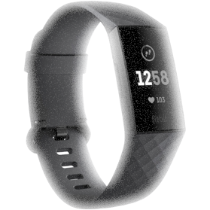
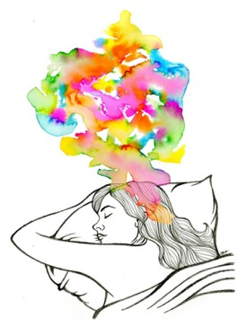
Method overview
Experience sampling method (ESM)
  Dynamic, in situ setting, with a proximal measurement
Behaviorally capturing sleep with actigraphy + surveys
  Established non-invasive method of monitoring sleep
  Wrist devices with 3D accelerometers
  (de Souza et al., 2003; Jean-Louis et al., 1996; Sadeh, Sharkey, & Carskadon, 1994)
Actigraph used = Fitbit Charge 3
  Map the measured signals onto sleep patterns
  (Beattie, Oyang et al., 2017; Beattie, Pantelopoulos et al., 2017;
  de Zambotti et al., 2017; Liang, & Chapa Martell, 2018)
Notes:
Validation studies have confirmed the accuracy of actigraph-measured sleep
widespread use for measuring sleep for both clinical and research purposes.
Validation papers:
These papers cited in the field of neuroscience compared the use of commercial grade actigraphs Fitbit with a polysomnographic device (largely used in sleep studies.
They found that there is reasonable degree of sleep staging accuracy can be achieved using a wrist-worn device,
This is even more hepful in longitudinal studies of sleep habits where the variance associated with each device is removed with CWC.

Slide 21
Sample
Employees from a digital services firm
  Located in Mauritius
  Roles: customer service, telemarketing, copywriting
71 employees, average 5 employee-day observations
  Final N = 351
Demographics
  27.7 years old (SD = 5.42)
  Predominantly women (60.3%)
  An undergraduate degree (30.1%)
  Average tenure of 4.31 years (SD = 4.0)

Slide 22
Procedure
1) In-person briefing
  Expimetrics: programmed surveys on mobile phone
  Fitbit: data synced to Fitbit’s API
  Collected instrument packet with the Fitbit Charge 3 + instruction booklet
2) (Wear the Fitbit + 2 daily surveys) 10 work days
  Time 1 survey: 12pm – 2pm
  Time 2 survey: 4:30pm – 8:30pm
3) Debriefed + pro-rated compensation of $35
Notes:
Go through this in less details

Slide 23
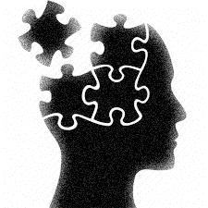
Primary measures
REM sleep (Fitbit)
  [ICC = 69%]
State recovery¹ (Time 1)
  3-items; e.g. “Today, I feel recovered”
  [ICC = 48%, α = .83]
    1 = Strongly disagree; 5 = Strongly agree
Job burnout² (Time 2)
  3-items; e.g. “I have no energy for going to work the next day”
  [ICC = 54%, α = .79]
    1 = Strongly disagree; 5 = Strongly agree
¹Sonnentag (2003), ²Shirom & Melamed (2006); ICC = % of within-individual variance
Notes:
Shortened from 6-item to 3-items (one for each dimension) using an Mturk (n=239) sample
Reliabilities across days (reliability of each day and averaged across)

Slide 24
Primary measures
Emotional labor¹ (Time 1)
  Surface acting
  3-items; e.g. “Today, I resisted expressing my true feelings”
  [ICC = 46%; α = .76]
  Deep acting
  3-items; e.g. “Today, I tried to actually experience emotions that I must show”
  [ICC = 56%; α = .81]
    1 = Not at all; 5 = Extremely
¹Brotheridge & Lee (2002); ICC = % of within-individual variance
Notes:
Shortened from 6-item to 3-items (one for each dimension) using an Mturk (n=239) sample
Reliabilities across days (reliability of each day and averaged across)

Slide 25
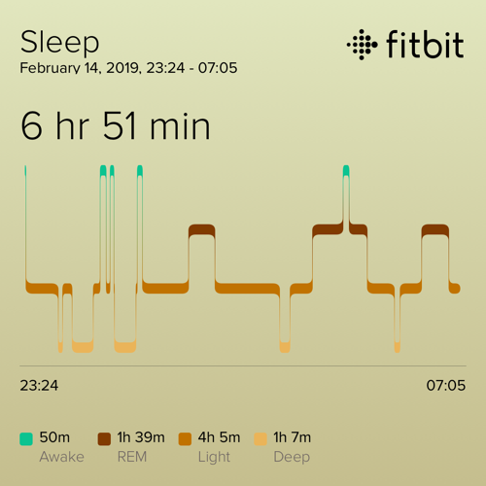
Control measures
(NREM) Light sleep (Fitbit)
[ICC = 75%]
(NREM) Deep sleep (Fitbit)
[ICC = 81%]
Subjective sleep quality¹ (Time 1)
  3-item; e.g. ”Last night, I woke up several times”
  [ICC = 75%, α = .87]
    1 = To a very small extent, 5 = To a very large extent
Subjective sleep quantity² (Time 1)
  “How many hours did you sleep last night?”
  [ICC = 78%]
¹Scott & Judge (2006) , ²Barnes et al. (2015); ICC = % of within-individual variance
Notes:
Different aspects of sleep processes
Different operationalizations of sleep (based on extant literature)
Lagged effect of the mediator
The mediator was lagged to help bolster evidence for the causal statements
Reliabilities across days (reliability of each day and averaged across)

Slide 26
Analytical procedure
Centered predictors within a person’s mean (Enders & Tofighi, 2007)
Random coefficient modeling in R (Pinheiro & Bates, 2000)
Monte Carlo simulation for conditional-indirect effect (Tofighi & MacKinnon, 2016)
Confirmatory factor analyses in Lavaan
  Supporting for a four-factor model
Notes:
Centered predictors within a person’s mean (Enders & Tofighi, 2007)
Random coefficient modeling in R (Pinheiro & Bates, 2000)
Daily observations are nested within participants
Restricted maximum likelihood approach
Robust to missing data (regardless of the pattern)
Monte Carlo simulation for conditional-indirect effect (Tofighi & MacKinnon, 2016)
Reflects the asymmetric nature of the sampling distribution
20,000 replications
95% confidence interval
Confirmatory factor analyses in Lavaan
Four-factor model of latent variables fits the data better than alternative models
χ² (48) = 98.43 (p < .001), CFI = .98, NFI = .96, TLI = .97, RMSEA = .03 (LLCI = .02, ULCI = .04)

Slide 27
Results: Test of hypotheses (H1 & H2)
REM sleep
State recovery
Job burnout
.23 *
-.16 *
.13 *
Sleep quantity
Sleep quality
Light NREM sleep
Deep NREM sleep
State recovery
(D-1)
Notes:
The most conservative results (WITH controls are presented)

Slide 28
Results: Indirect effect (H3)
 | LLCI | ULCI | Estimate | S.E. | Monte Carlo estimate
Indirect effect | -0.043 | -0.002 | -0.020 | 0.012 | 1.29E-07
REM sleep
State recovery
Job burnout
Notes:
Substitutive interaction effect of deep acting

Slide 29
Results: Test of hypotheses (H4)
Surface
acting
Deep
acting
-.09 (ns)
-.32 *
REM sleep
State recovery
Job burnout
.23 *
-.16 *
.13 *
Sleep quantity
Sleep quality
Light NREM sleep
Deep NREM sleep
State recovery
(D-1)
Notes:
The most conservative results (WITH controls are presented)

Slide 30
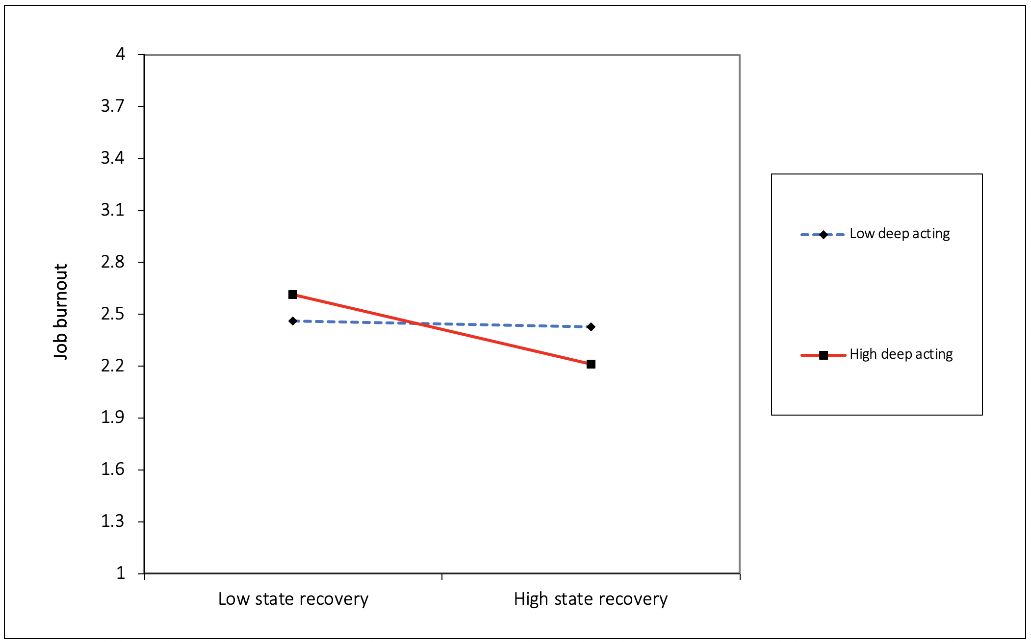
Results: Conditional effect of deep acting (H4b)
γ = -.03, t = -.33, p = .74
γ = -.34, t = -3.00, p = .003
Notes:
More deep acting, even less burnout (compared to less deep acting)
Simple slopes analyses suggest a substitutive interaction effect
These benefits do not perspire with deep acting in low.

Slide 31
Results: Conditional-indirect effects (H5)
Surface acting
 | Moderator | LLCI | ULCI | Estimate | S.E. | Monte Carlo estimate
Conditional-indirect effect | Low surface acting | -0.054 | 0.020 | -0.013 | 0.023 | 2.30E-07
 | High surface acting | -0.086 | 0.000 | -0.037 | 0.027 | 2.65E-07
Deep acting
 | Moderator | LLCI | ULCI | Estimate | S.E. | Monte Carlo estimate
Conditional-indirect effect | Low deep acting | -0.020 | 0.009 | -0.003 | 0.009 | 9.04E-08
 | High deep acting | -0.081 | -0.005 | -0.040 | 0.023 | 2.35E-07
Notes:
Substitutive interaction effect of deep acting
Regardless of the level of surface acting they engage in, there are no differences in how the amount of job burnout employees report on a daily basis, as predicted by the amount of REM sleep they obtain.
On days when employees engage in more deep acting, this strengthens the relationship that REM sleep has in reducing job burnout
On days when employees engage in lower than average levels of deep acting, this relationship does not appear to manifest. However it does for average levels of deep acting and above average levels of deep acting.
This suggests a substitutive interaction effect where the benefits of REM sleep for daily burnout depends on the level of deep acting employees engage in.

Slide 32
Supplementary analyses
Dependence on controls variable? (Spector & Brannick, 2011)
  Similar pattern of results with or without controls
Cross-level isomorphism? (Thurnheer et al., 2001)
  No support for between-individuals (Level-2) analysis
Model-based constraint procedure for mediation effect (Tofighi & Kelley, 2020)
  LRT_{MBCO} = 9.15, df_{LRT} = 1, p = .002
Notes:
(Go through this quickly)
Too much REM?
Five more minutes.
Are there any drawbacks to snoozing?
I could consider running a cross-lagged random coefficient model
Reciprocal influence of T1 and T2 measure where they predict each other

Slide 33
Theoretical contributions
Suggest new ways of approaching sleep in the organizational sciences
  Recognizing sleep as a dramatically diverse collection of different brain states
  COR approach: an explanatory pathway to better understand sleep
Suggest insights on how people acquire new resources
  The state of sleep where the brain is highly and intensively active is associated with the ability to engage in work demands
Suggest benefits of incorporating brain processes in the organizational sciences
(Becker & Cropanzano, 2010; Lee, Senior & Butler, 2012)
  By theorizing and capturing aspects of the brain, we can better theorize about employee cognition, attitude, emotion, and behavior

Slide 34
Practical implications
Benefits of extending full night’s sleep (esp. in highly demanding jobs)
  Are naps (at work) effective to reduce job burnout?
Professions with non-regular job hours are susceptible to job burnout
  Policies and managerial decisions that foster a full 8 hours of sleep may benefit the firm
Managers may want to ensure that employees focus on deep acting
  Emotional labor programs may be helpful to garner the benefits of REM sleep
Restricting work-related use of electronic devices closer to bedtime
  Electronic devices emit bluelight that limit REM sleep
Notes:
What recommendation would present-Dorian have made to past-Dorian?
What recommendation would Dorian-the-scholar have made to Dorian-the-bar-manager?
Many companies in Asia (and South America) have a mandatory nap

Slide 35
Limitations & future research
Limited inference of causality
  Future studies: experimentally manipulate REM sleep
Theory modeled at the within-individual level
  Future studies: modeling the within-day level
Future research may want to examine
  The benefits of REM sleep for enhancing creativity
  The benefits of REM sleep to reducing negative emotional charge of work experiences
  The benefits of NREM sleep for energy at work
Notes:
“As with all studies, this paper has a couple of limitations based on strategic (analytic) choices that were made”
Future tests to run:
Cross-lagged modeling
Relative importance test

Slide 36
My on-going program of research
Promises of diversity and inclusion
Sleep and work (dissertation)
Perils of incivility at work
Affective processes
Abusive supervision & deviance
(JBE, 2020)
REM sleep and job burnout (writing)
Diversity climate &creativity (Personnel Psychology, 2019)
REM sleep and job performance (analysis)
Sleep states and energy (Data collection)
Engagement and counterproductive work behavior (JBR, 2020)
Receiving gratitude in inclusive climates (Under review, OBHDP)
Contingencies of the diversity to firm performance relationship
(Under review at JMS)
Intraorganizational and community diversity (targeted for JAP)
Workplace harassment & deviance (writing for Personnel Psychology)
Affective shifts & job burnout
(targeted for OBHDP)
Workplace loneliness (writing for AMR)
Notes:
How do we get all people to thrive in their organizations?
Diversity & inclusion Personnel Psychology (2019)
How do we know that an organization’s human capital is deteriorating?
Incivility & counterproductive work behavior (CWB) Journal of Business Ethics (2020); Journal of Business Research (2020)
How do employees restore their ability to contribute to their organizations on a daily basis?
Sleep: “A conservation of resources theory approach to the multiple dimensions of sleep in organizational behavior”

Slide 37
Thank you!
O. Dorian Boncoeur
University of Texas at Dallas
Dorian.Boncoeur@utdallas.edu
(917) 504 2549

Slide 38
Appendix

Slide 39
Results: Variance decomposition
Variable | Within-individual variance (σ²) | Between-individual variance (τ₀₀) ICC | Percentage of within-individual variance
Sleep quantity | 1.65 | 0.46 | 78%
Sleep quality | 0.59 | 0.19 | 75%
NREM light sleep | 2509.91 | 826.38 | 75%
NREM deep sleep | 456.52 | 104.92 | 81%
REM sleep | 714.75 | 320.94 | 69%
Recovery | 0.45 | 0.46 | 48%
Surface acting | 0.47 | 0.49 | 46%
Deep acting | 0.41 | 0.56 | 41%
Job burnout | 0.49 | 0.59 | 54%
Note. σ² = within-individual variance in the dependent variable. τ₀₀ = between-individual variance in the dependent variable. Percentage of variability within-individual was computed as σ²/(σ² + τ₀₀). p < .05
Notes:
Variance within the variance
Pattern that we would expect with ICCs
Behaviors are more consistent
Psychometrics vary day by day (attitude and cognition are influenced by so much more)

Slide 40
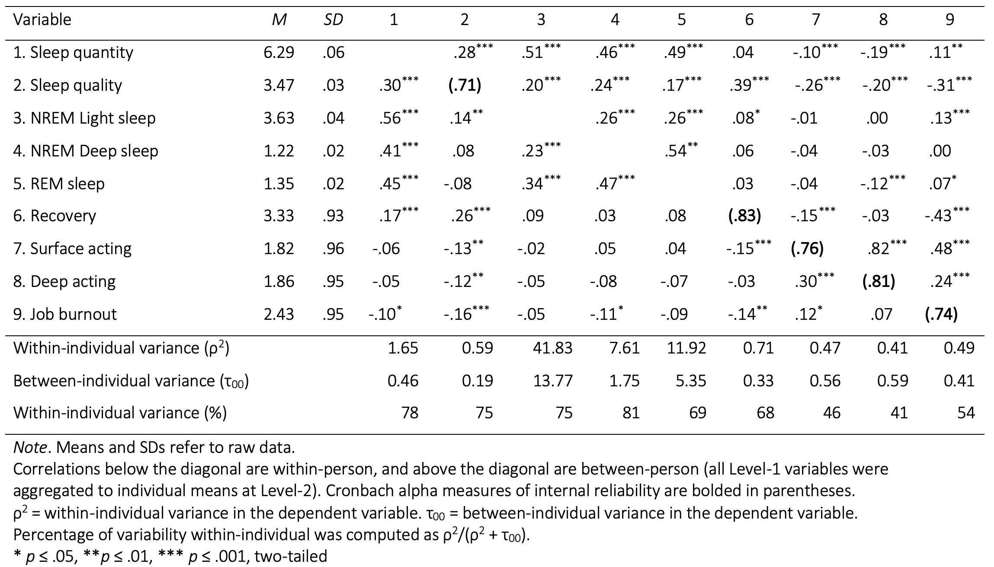
Notes:
Reliabilities across days (reliability of each day and averaged across)

Slide 41
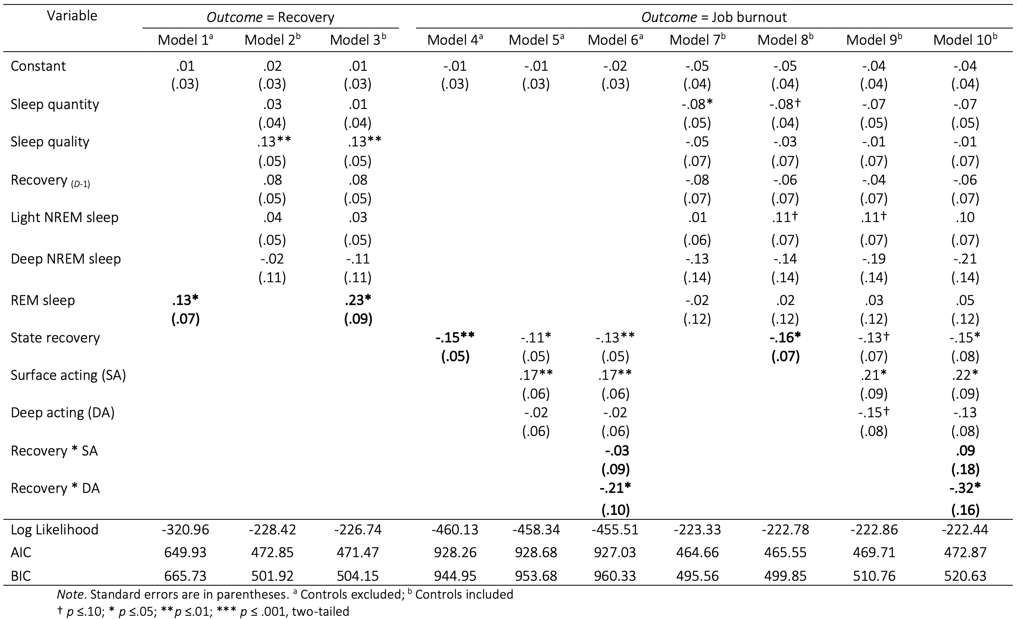

Slide 42
Confirmatory Factor Analyses
 | χ² | df | χ²/df | p-value | NFI | RFI | IFI | TLI | CFI | RMSEA | RMSEA CI
4-factor | 98.43 | 48 | 2.05 | 0 | 0.962 | 0.948 | 0.98 | 0.967 | 0.98 | 0.031 | [.022, .040]
Recovery-Burnout-Emotional Labor | 355.97 | 51 | 6.98 | 0 | 0.861 | 0.788 | 0.879 | 0.813 | 0.878 | 0.075 | [.067, .082]
1 Factor solution | 1446.18 | 54 | 26.78 | 0 | 0.437 | 0.187 | 0.446 | 0.193 | 0.441 | 0.155 | [.148, .162]
Notes:
fits the data better than any combinations of either a three-factor model (Δχ² ⁼ 261.12, Δ df =3, p ≤ .001),
a two-factor model (Δχ² ⁼ 944.02, Δ df = 5, p ≤ .001),
a one-factor model (Δχ² ⁼ 1352.3, Δ df = 6, p ≤ .001)
Cmin = Chi Square statistic
Df = Degrees of freedom
NFI = (Bentler-Bonett) Normed Fit Index
RFI = Relative fit index
IFI = (Bollen’s) Incremental Fit Index
TLI = Tukey-Lewis index
CFI = Comparative fit index
RMSEA = root mean square error of approximation
RMSEA CI = root mean square error of approximation confidence interval

Slide 43
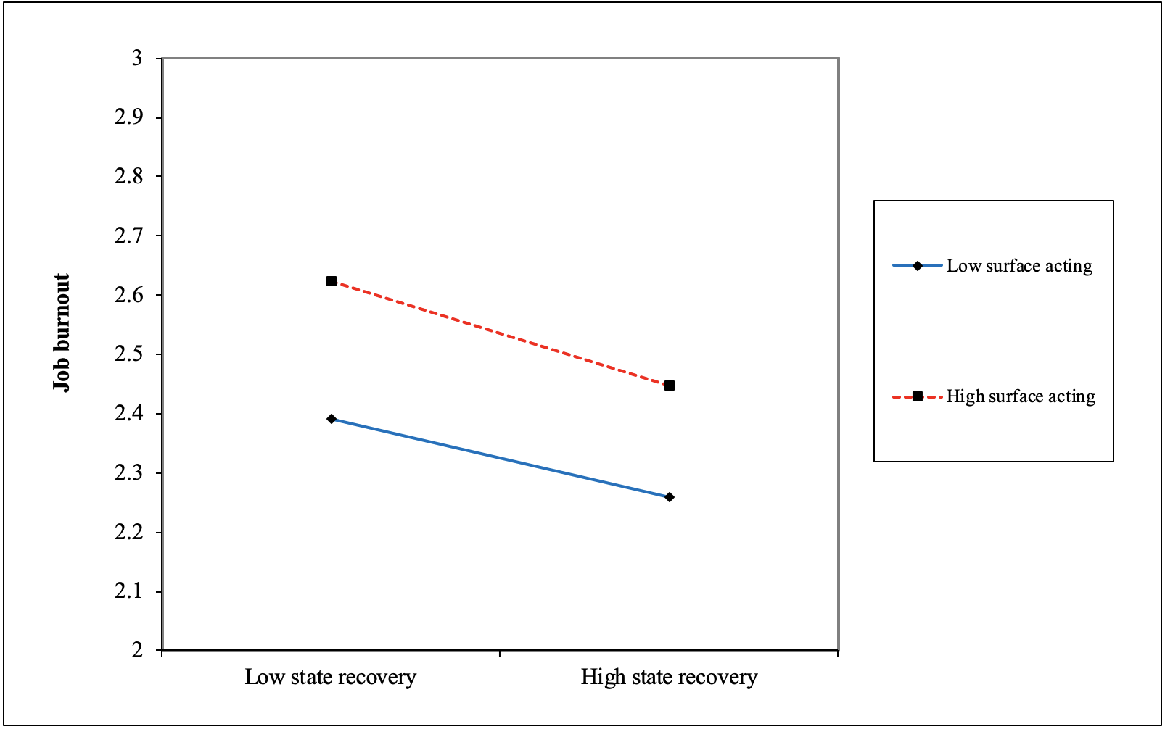
Results: Surface acting (conditional effect)
γ =-.17, t = -1.81, p = .08
γ = -.06, t = -.06, p = .95
Notes:
(Introduces axes and lines)
Same pattern regardless of surface acting

Slide 44
Results: Test of hypotheses
Surface
acting
Deep
acting
-.09 (ns)
-.32 *
REM sleep
State recovery
Job burnout
.23 *
-.16 *
Sleep quantity
Sleep quality
Light NREM sleep
Deep NREM sleep
State recovery
(D-1)
Notes:
The most conservative results (WITH controls are presented)

Slide 45
Results: Conditional-indirect effect (Monte Carlo)
 |  | LLCI | ULCI | Estimate | S.E. | Monte Carlo estimate
Indirect effect | Controls excl. | -0.0434 | -0.0020 | -0.0200 | 0.0128 | 1.29E-07
 | Controls included | -0.0799 | -0.0045 | -0.0366 | 0.0235 | 2.35E-07
 |  | Conditional-indirect effect
 | Moderator | LLCI | ULCI | Estimate | S.E. | Monte Carlo estimate
Controls excl. | Low deep acting | -0.0200 | 0.0094 | -0.0039 | 0.0090 | 9.04E-08
 | High deep acting | -0.0815 | -0.0048 | -0.0404 | 0.0235 | 2.35E-07
Controls incl. | Low deep acting | -0.0481 | 0.0306 | -0.0072 | 0.0240 | 2.40E-07
 | High deep acting | -0.1575 | -0.0191 | -0.0795 | 0.0427 | 4.27E-07

Slide 46
Theoretical model
Surface
acting
Deep
acting
REM sleep
State recovery
Job burnout

Slide 47
Measure | Source | Stem | Item
(Subj.) Sleep quantity | Barnes et al., (2011 OBHDP) |  | How long did you sleep for yesterday night?
(Subj.) Sleep quality | Scott & Judge (2006 JOM) | To what extent do you agree with the following statement: Last night… | I had trouble falling asleep ®
 |  |  | I had trouble staying asleep ®
 |  |  | I woke up several times last night ®
 |  |  | I woke up after my usual amount of sleep feeling tired and worn out ®
State recovery | Sonnentag (2003 JAP) | To what extent do you agree with the following statements? | Today, I feel relaxed
 |  |  | Today, I feel recovered
 |  |  | Today, I am in a good mood
Surface acting | Brotheridge & Lee (2003 JOOP) | Today, to what extent do you perform these behaviors to be effective at your job? | Today, I resisted expressing my true feelings
 |  |  | Today, I pretended to have emotions that I didn't really have
 |  |  | Today, I hid my true feelings about a situation
Deep acting | Brotheridge & Lee (2003 JOOP) | Today, to what extent do you perform these behaviors to be effective at your job? | Today, I made an effort to actually feel the emotions that I need to display to others
 |  |  | Today, I really tried to feel the emotions I have to show as part of my job
 |  |  | Today, I tried to actually experience emotions that I must show
Job burnout | Shirom Melamed Burnout Inventory (Shirom & Melamed, 2006) | To what extent do you agree with the following statements? | Today, I have no energy for going to work the next day.
 |  |  | Today, I feel I am not thinking clearly.
 |  |  | Today, I feel I am not capable of investing emotionally in coworkers and customers.

Slide 48
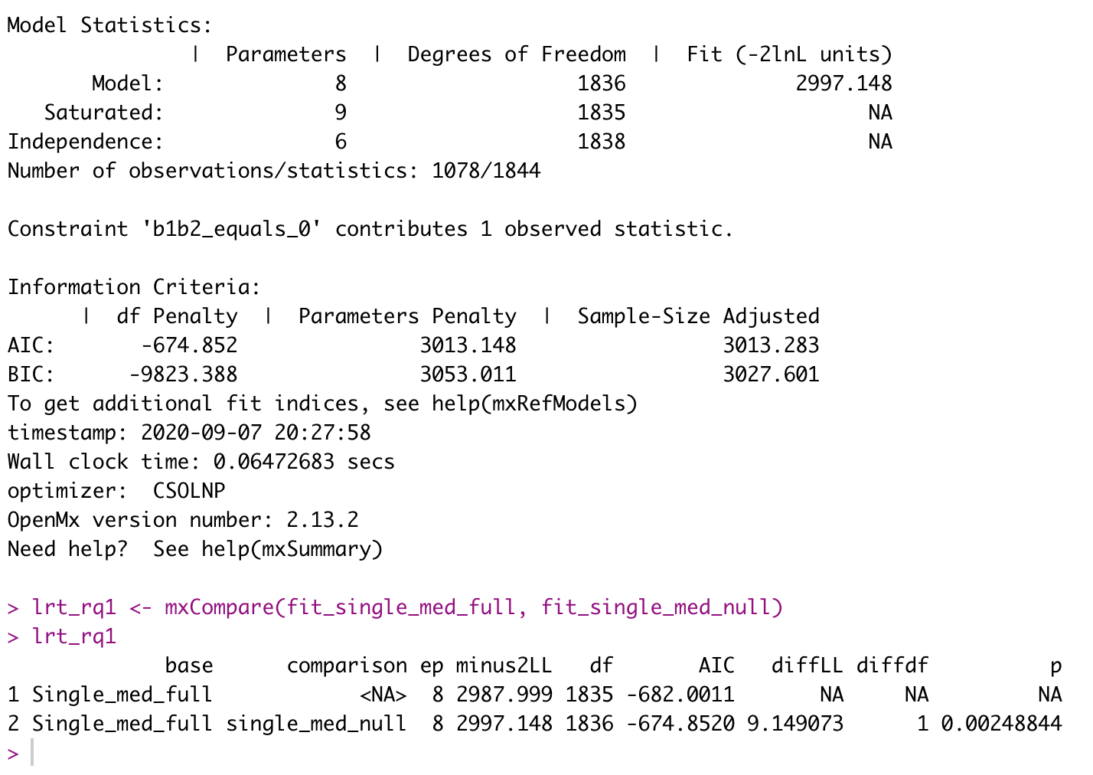

Slide 49
Variable | M | SD | 1 | 2 | 3 | 4 | 5 | 6 | 7 | 8 | 9 | 10
1. Subj. sleep quantity | 6.29 | 1.46
2. Sub. sleep quality | 3.48 | 0.88 | .26**
3. Obj. sleep quantity | 6.02 | 1.73 | .68** | .16**
4. Microwakes duration | 0.93 | 0.32 | .45** | 0.02 | .62**
5. Microwakes count | 26.00 | 8.13 | .57** | .13** | .73** | .54**
6. NREM light sleep duration | 3.63 | 0.95 | .61** | 0.07 | .84** | .66** | .63**
7. NREM light sleep count | 25.24 | 7.56 | .54** | .12* | .71** | .60** | .89** | .72**
8. NREM deep sleep duration | 1.22 | 0.40 | .43** | .11* | .61** | .34** | .45** | .22** | .35**
9. NREM deep sleep count | 3.63 | 1.39 | .37** | 0 | .52** | .35** | .45** | .36** | .52** | .50**
10. REM sleep duration | 1.35 | 0.53 | .47** | 0.03 | .68** | .20** | .45** | .25** | .31** | .46** | .34**
11. REM sleep count | 8.01 | 3.90 | .46** | 0.09 | .60** | .26** | .65** | .27** | .39** | .47** | .33** | .74**

Slide 50
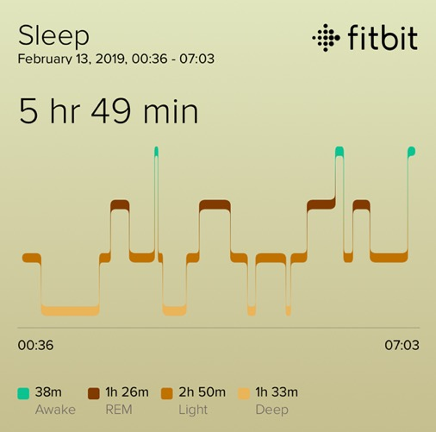
Theory: A hypnogram of sleep processes
Notes:
Not all sleep is created equal
What happens during sleep? (variance in numbers)
Each night’s sleep has its own internal structure; every night is a unique sleep pattern for the individual
Shift is the qualitative nature of the process? Same amount of REM
Sleep may be divided into two phases
Non-rapid eye movement (NREM) sleep
Rapid eye movement (REM) sleep
The states vary in occurrences each night and in length each cycle
Repeat on average every 90 minutes
Punctuated by brief moments of awakening between transitions

